Slide 1
Summary of Internship
Haixiang Xu
hxu@Caltech.edu
Sep. 07, 2016

Slide 2
Contents
Magnetic gadget – Magneto
Customized design
Prototyping
General summary of 3-D printing
Magnetometer with Arduino
Hardware selection
Interfacing with sensors and data acquisition program
General summary of Arduino-based automation
Burda H, Begall S, Červený J, Neef J, Němec P. Extremely low-frequency electromagnetic fields disrupt magnetic alignment of ruminants. Proceedings of the National Academy of Sciences of the United States of America. 2009;106(14):5708-5713. doi:10.1073/pnas.0811194106.

Slide 3
Magneto design
Bobbin shaped electromagnet
PLA casing made from 3-D printing
1000 rounds of magnetic coil wiring (30 AWG wire)
Iron core
Drive from 3.5mm jack
Work well at room temperature

Slide 4
Magneto features
R = 17 ± 1 Ohm static
Field amplitude when powered by audio jack
Max ~1000 mT, 30x of earth field
Typical 200 ~ 300 mT, 10x of earth field
Attenuated sharply when shifted from central axis

Slide 5
Magneto
Prototyping
Trial and error to find the right dimension
6 iterations of design
50 products in stock

Slide 6
3-D Prototyping
Design with CAD software
Inventor
Microsoft 3D Builder
Convert to industry standard file formats
stl
gcode
Layer and slice the instance
Cura
Choose printer and customize configuration
Bukito
MOD-t

Slide 7

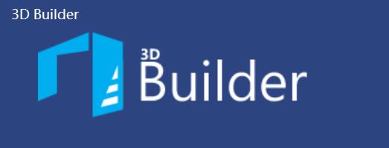
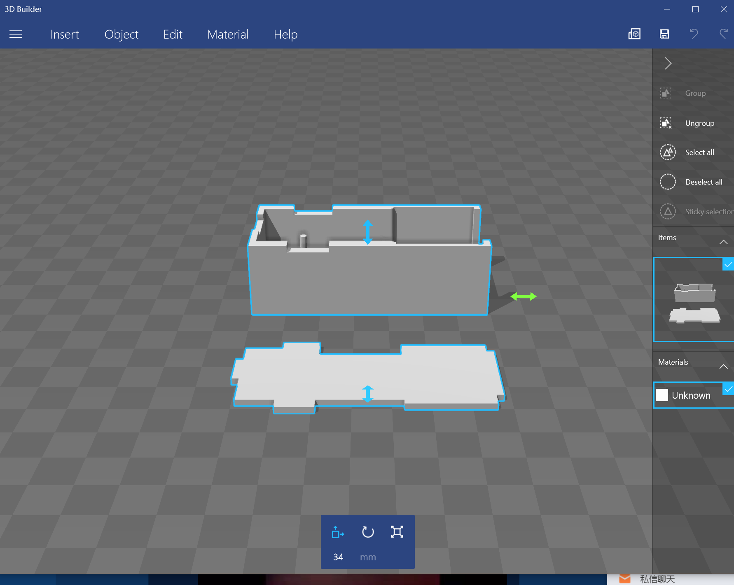
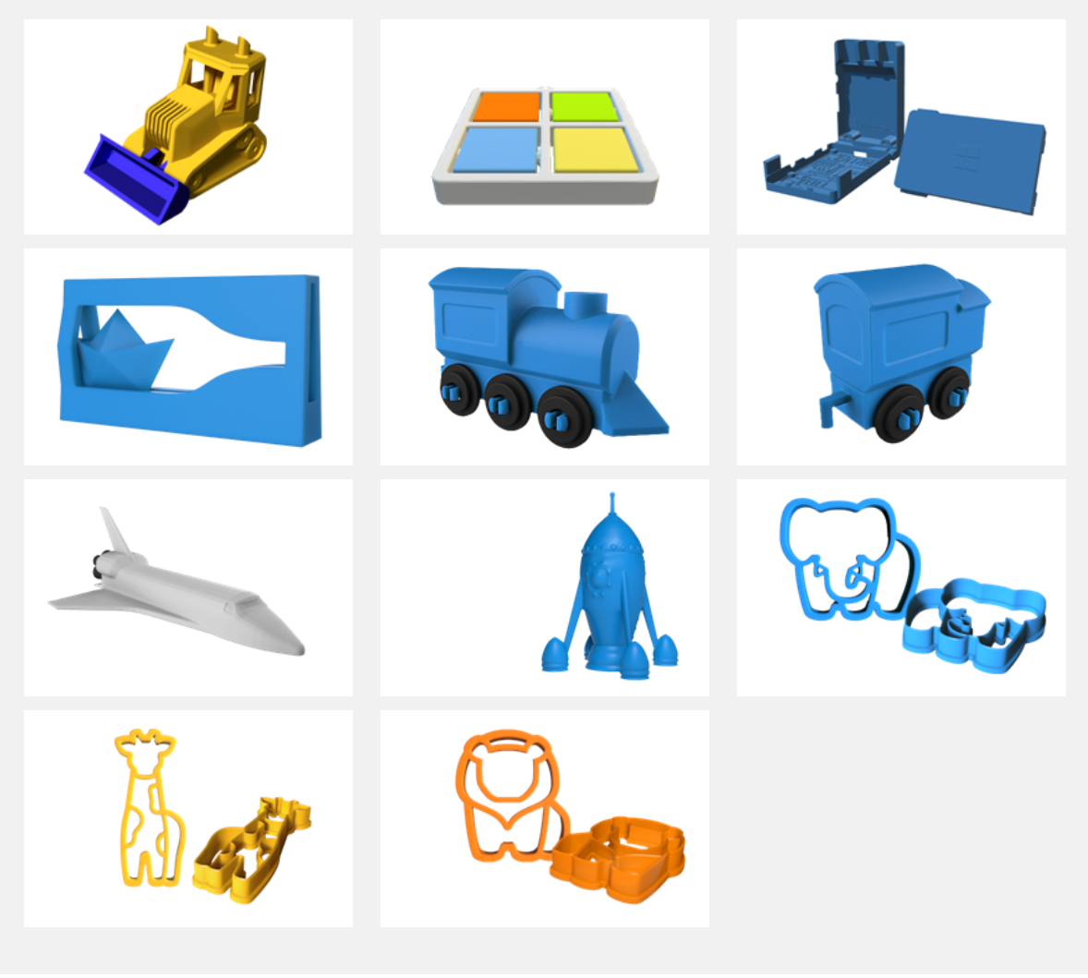
3-D Prototyping
Design with CAD software
Inventor
Microsoft 3D Builder

Slide 8
3-D Prototyping
Design with CAD software
Inventor
Microsoft 3D Builder
Convert to industry standard files
stl
gcode
Layer and slice the instance
Cura
Choose printer and customize configuration
Bukito
MOD-t

Slide 9
3-D Prototyping
Design with CAD software
Inventor
Microsoft 3D Builder
Convert to industry standard files
stl
gcode
Layer and slice the instance
Cura
Choose printer and customize configuration
Bukito
MOD-t

Slide 10
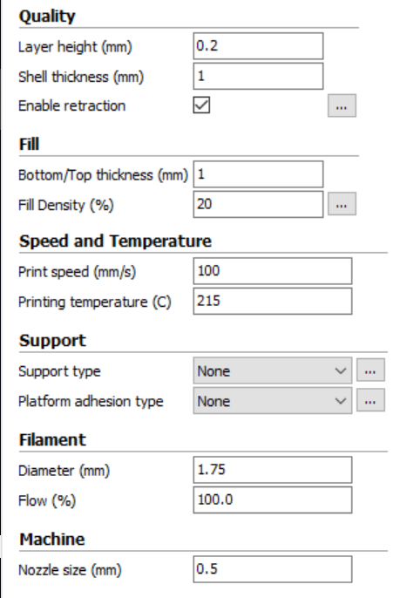
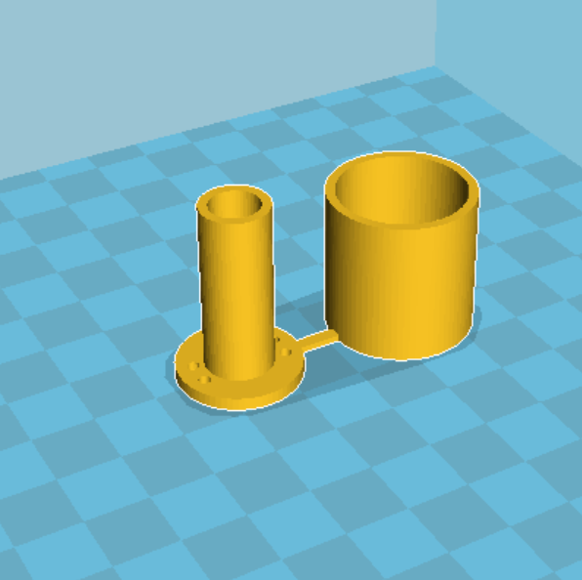
3-D Prototyping
Layer and slice the instance
Cura

Slide 11
3-D Prototyping
Design with CAD software
Inventor
Microsoft 3D Builder
Convert to industry standard files
stl
gcode
Layer and slice the instance
Cura
Choose printer and customize configuration
Bukito
MOD-t

Slide 12
3-D Prototyping Pros
Fast, Iterative, Convenient
Best way to fast develop a prototype and iteratively improve it
Cheap
Typically $500 - $800 machine (can be expensive as ~$3000) and ~$20 filament
FREE in Caltech TechLab

Slide 13
3-D Prototyping Cons
Accuracy! Accuracy! Accuracy!
0.25 mm injector, step motor driving belts
expected accuracy of ±0.5mm
Melts at high temperature
Injector heats up to 210 ºF for PLA material
Use only at room temperature
Mechanical strength
Breaks easily along the horizontal direction without support
Bio-compatible material
If prototyping with bio-sensitive surface, TechLab provides additional filament.

Slide 14
Magnetometer
Functionality
USB power and data transmission
Real-time plot of data and auto-save into plain txt
Hardware selection
MAG3110 magnetic sensor
Fio v3 control board
Accessories, Dupont wire and USB cable
3-D printed outer case
Zero-field calibration cylinder
SPI Protocol for data transmission between board and sensor

Slide 15
Play with Arduino
Arduino:
setup()
Initialize, calibrate during the initialization
Set up communication ports
Set up registers
Constant values
loop()
Loop through the main program
Waiting for input or communication
Single-threading, simple and easy, usually fulfills most purposes
Multi-threading, usually used in communication app, interruptions

Slide 16
Play with Arduino
VCC (Power)
GND (Ground)
SCL (Clock)
SDA (Data signal)
Inter-Integrated Circuit (I²C) protocol
Arduino Wire Library
Communication with PC
USB Serial
Supply power
Break-out board for sensors and motors
Interrupts
Driver circuits

